Slide 1

Target Non-Brand CPA
£50
Restructure & Growth Plan
Down from £64 — a 22% reduction within 90 days
+29%
90 Days
£12,000/mo
Dental by Design | Prodent Group
More Leads (Same Budget)
To Full Impact
Potential Monthly Saving
Christopher Hoole
Google Ads Specialist | April 2026
christopherhoole.com
Based on data: 2025 (full year) + 2026 (Q1)

Slide 2
Executive Summary
Restructure Plan
£50
+236/mo
90 Days
£53,990
Target Non-Brand CPA
Additional Leads (Same Budget)
Time to Full Impact
Current Monthly Spend
Restructure Plan Summary
Week 1: Fix conversion tracking (remove 1,511 KMG ghosts, move soft signals to Secondary), implement negative keyword overhaul (9-list system), disable auto-apply.
Weeks 2-4: Rewrite all Poor/Average ads (the #1 CPA lever), implement device + schedule + day-of-week bid adjustments, evaluate bid strategy (tCPA vs tROAS with real values).
Month 2: Restructure geo targeting from radius to postcodes, keyword optimization based on first month of clean data, landing page traffic routing improvements.
Month 3: Scale winning campaigns, establish per-clinic benchmarks, begin multi-clinic rollout planning. Full reporting framework.
Conservative projection: Reducing non-brand CPA from £64 to £50 within 90 days. At the current £53,990/month spend, this means 236 additional patient leads per month or £12,000/month in savings.
Christopher Hoole | christopherhoole.com | Confidential
2

Slide 3
Step 1: Fix Conversion Tracking
Week 1
The foundation — everything else depends on clean data
Conversion Action | Current | Proposed | Why
KMG OLD LP | Book A Free Consult | Primary | Remove | Ghost data — confirmed by Giulio. 1,250 phantom conversions.
KMG OLD LP | Website Phone Call | Primary | Remove | Ghost data — legacy landing page. 57 phantom conversions.
KMG | Call Extension | Primary | Remove | Legacy agency call extension. 204 phantom conversions.
Online Booking Click | Primary | Secondary | Click, not a booking. 264 soft signals misleading algorithm.
Phone Click | Primary | Secondary | Click, not a call. 123 soft signals.
WhatsApp Click | Primary | Secondary | Click, not a conversation. 48 soft signals.
Conversation Started | Primary | Secondary | Chat opened, not a lead. 10 soft signals.
Dengro Offline Lead | Primary | Keep (verify) | Real CRM lead — but verify it only counts ad-sourced leads.
Dengro Offline Booking | Primary | Keep | Real booking. £300 arbitrary value — replace with actual treatment value.
Calls from the ads | Primary | Keep | Real phone calls. 965 legitimate conversions.
Impact
Removing 1,511 ghost + 445 soft signal conversions will cause reported CPA to rise from £49 to ~£71. This isn't a deterioration — it's seeing the real numbers for the first time.
ROAS Values
Replace the arbitrary £300 booking value with actual treatment revenue: • Single implant: £1,695 • All-on-4: £9,995 • Vivo Bridge: £15,990 This lets the algorithm bid more for high-value treatments.
This is a 30-minute fix with outsized impact. Clean tracking = better algorithm decisions = lower CPA.
Christopher Hoole | christopherhoole.com | Confidential
3

Slide 4
Step 2: Negative Keyword Overhaul
Week 1
Replace 784 broad match negatives with a structured 9-list system
Current Setup
Proposed: 9-List System
2,192 total negative keywords across the account: • 784 broad match at account level (dangerous — may block converting traffic) • 770 phrase match • 425 exact match • Scattered across 35 campaigns with no structure Auto-apply has removed 24 keywords including high-intent terms like [low cost dental implants] and [cheapest dental implants].
9 shared account-level lists organised by word count + match type: • 1 word — phrase + exact • 2 words — phrase + exact • 3 words — phrase + exact • 4 words — exact only • 5+ words — exact only All new negatives added as phrase or exact match only. No broad match. Weekly search term reviews to keep lists current.
The 9-list system blocked £59,349 of search term waste in Q1 2026. A structured negative keyword framework is the most cost-effective optimization available.
Priority Negative Keyword Categories
Category | Examples | 2025 Waste | 2026 Waste | Match Type
Price Research (no location) | implant cost uk, how much is dental implants | £20,540 | £14,211 | Phrase
Wrong Treatment | implant dentures, dental bridge, dental crown | £3,112 | £3,661 | Phrase
Competitor / Tourism | brighton implant clinic, turkey teeth | £1,724 | £1,390 | Exact
NHS / Free | nhs dental implants, free dental implants | £1,378 | £801 | Phrase
Christopher Hoole | christopherhoole.com | Confidential
4

Slide 5
Step 3: Ad Copy Rewrite
Weeks 2-4
90% of ads rated Poor or Average — the #1 lever for reducing CPA
90%
71%
6.4
#1
Ads Rated Poor/Average
Keywords with Below Avg Ad Relevance
Weighted Avg QS (down from 6.9)
CPA Reduction Lever
Proposed Ad Testing Framework
Ad Group | Current Strength | Angle 1 (Price) | Angle 2 (Speed) | Angle 3 (Quality)
Dental Implants | Poor | From £1,695. 0% Finance. | Permanent Teeth in 48 Hours. | 4.8★ Rating. 399+ Reviews.
Implants Cost | Poor | Up to 60% Less Than Other Clinics. | Same-Day Consultation Available. | In-House Lab. Premium Materials.
All on 4 | Poor | Full Arch From £9,995. | New Teeth in 48 Hours. Walk Out Smiling. | CQC Registered. Expert Surgeons.
Financing | Average | 0% Finance. From £47/month. | Book Free Consultation Today. | Trusted by 399+ Patients.
Invisalign | Average | Invisalign From £2,500. | Free Scan. Results in 6 Months. | Diamond Apex Provider.
Testing Plan
Expected Impact
2-3 RSA variants per ad group, each testing a different messaging angle. Run for 4-6 weeks, then keep winner and test new challenger. Every headline must match the keyword intent in that ad group.
Improving ad relevance from Below Average to Average on the top 20 keywords would lift QS by 2-3 points, reducing CPC by an estimated 20-30%. At £53,990/month spend, that's £10-16K/month in CPC savings.
Christopher Hoole | christopherhoole.com | Confidential
5

Slide 6
Step 4: Bid Strategy
Weeks 2-4
Switch from arbitrary ROAS to Target CPA — or use real treatment values
Campaign | Current Strategy | Current Target | Proposed | Rationale
PMax | Max Conv Value (tROAS) | 30% ROAS (£300 arb.) | tCPA £45 OR tROAS with real values | Arbitrary values mislead the algorithm
Search Intent | Max Conv Value (tROAS) | 60% ROAS (£300 arb.) | tCPA £65 (reduce to £50 by month 3) | Start conservative, tighten gradually
Brand | Max Conv Value (tROAS) | 10% ROAS | Keep or switch to Max Clicks | Brand always converts well — focus on IS
Option A: Target CPA (Recommended)
Option B: Target ROAS with Real Values
Switch all campaigns to Maximise Conversions with Target CPA. • PMax: Start at £45 (current £52), tighten to £40 as QS improves • Search: Start at £65 (current £94), tighten to £50 over 8 weeks • Never change target by more than 15-20% at a time Advantage: Simple, direct control over cost per lead. The algorithm optimises for lead volume at your price.
Keep Target ROAS but replace £300 arbitrary values with actual treatment revenue from Dengro. • Single implant booking: £1,695 • All-on-4 booking: £9,995 • Vivo Bridge booking: £15,990 Advantage: Algorithm bids more aggressively for high-value treatments. Risk: Requires reliable Dengro-to-Google Ads attribution.
Christopher Hoole | christopherhoole.com | Confidential
6

Slide 7
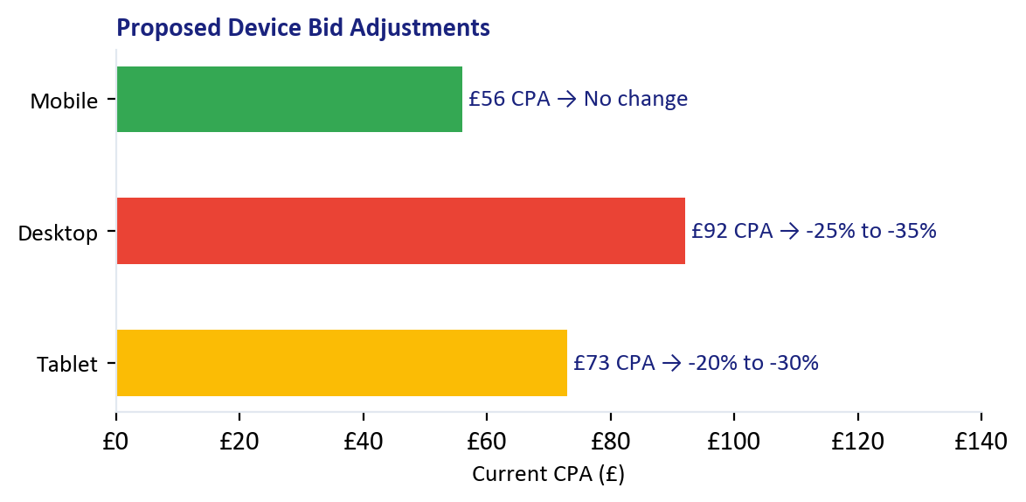
Step 5: Bid Adjustments
Weeks 2-4
Device, schedule, and day-of-week — no adjustments currently exist anywhere
Day of Week (2026 Data)
Day | 2025 CPA | 2026 CPA | Proposed Adj.
Monday | £41 | £64 | -5%
Tuesday | £44 | £62 | No change
Wednesday | £44 | £61 | No change
Thursday | £44 | £58 | +5%
Friday | £46 | £56 | +10%
Saturday | £43 | £56 | +10%
Sunday | £45 | £68 | -15%
Hour of Day Adjustments
Increase Bids (+10 to +15%)
Reduce Bids (-15 to -20%)
Hours 16-17 (4-5pm): Best CPA at £46-48 both years. High-volume, high-efficiency slot. Late afternoon is when patients are ready to book.
Hours 7-8 (7-8am): Worst CPA at £56-74 across both years. Early commute clicks are expensive and convert poorly. Reduce bids during this window.
Christopher Hoole | christopherhoole.com | Confidential
7

Slide 8
Step 6: Geographic Restructure
Month 2
Replace radius targeting with postcodes to unlock bid control per area
Current: Radius Targeting
Proposed: Postcode Targeting
Multiple overlapping radiuses around the clinic: • 30km ring: £59 CPA (2026) • 35km ring: £93 CPA (2026) Problems: • No bid adjustments possible on radius targets • Wider rings reach patients less likely to travel • Different campaigns target different radiuses — fragmented data
Individual London postcodes with bid adjustments per area: • Bid +20% for W6, W12, W3 (near clinic, low CPA) • No adjustment for mid-range postcodes • Bid -20% for outer postcodes (N13 £169, TW2 £137) All campaigns share the same postcode targets — one unified geographic view. Data from the matched locations report shows CPA ranges from £14 to £169 across postcodes.
Best Postcodes (2026, 3+ conv)
Worst Postcodes (2026, 3+ conv)
Postcode | CPA | Conv
SM4 | £14 | 5
EN4 | £14 | 3
CM18 | £15 | 3
WD7 | £18 | 4
SW13 | £19 | 3
Postcode | CPA | Conv
N13 | £169 | 3
TW2 | £137 | 5
WD23 | £123 | 5
SM3 | £123 | 4
N17 | £120 | 3
Christopher Hoole | christopherhoole.com | Confidential
8

Slide 9
Multi-Clinic Growth
Month 3+
How the optimised Dental by Design account becomes the blueprint for the partner network
Dental by Design
Partner Clinics
Flagship Clinic — Testing Ground
UK Network — Scaled Learnings
Highest budget = fastest learning
Test ad copy angles, keywords, bid strategies here
Establish CPA benchmarks per treatment type
Proven winning strategies become the playbook
Separate campaigns per clinic — tailored messaging + local targeting
Shared negative keyword lists — one block benefits all clinics
Performance-based budgets — best clinics earn more spend
Postcode targeting per clinic location — unified geographic view
▶
What Scales from Flagship to Network
9-List
Ad Copy
Bid Strategy
Reporting
Postcodes
Neg Keyword Framework
Winning Angles
tCPA Benchmarks
Monthly Framework
Geo Structure
Christopher Hoole | christopherhoole.com | Confidential
9

Slide 10
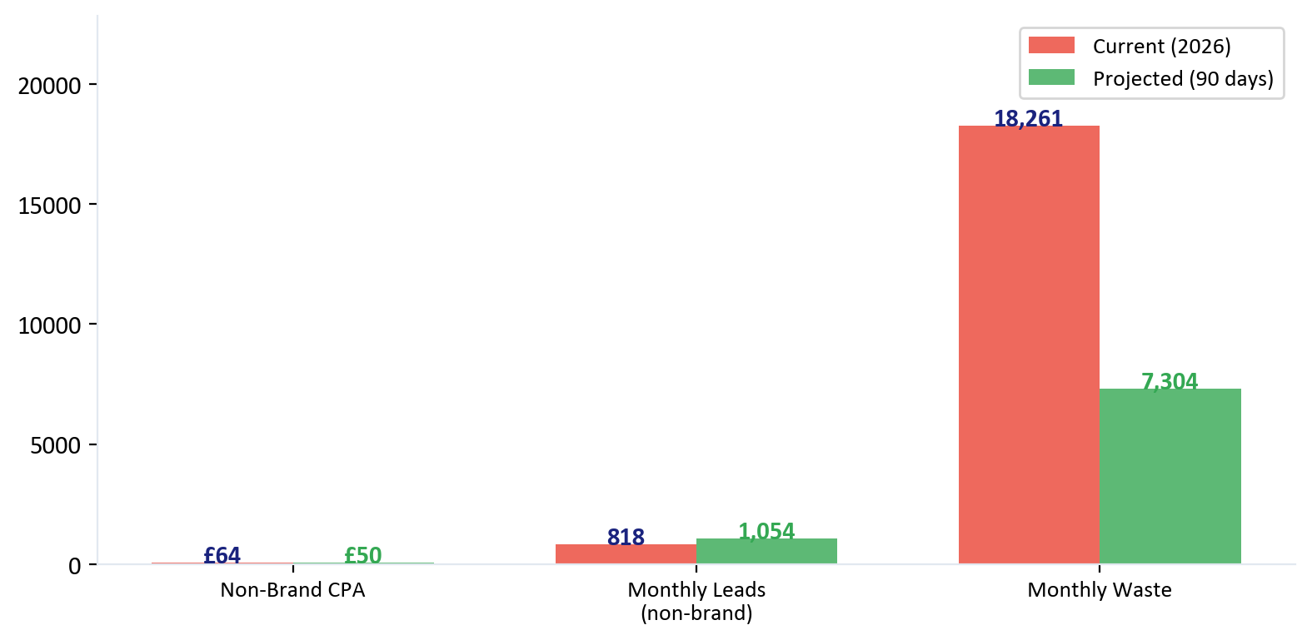
Projected Results
90-Day Target
Conservative projections based on the data in Reports 1 and 2
Scenario 1: More Leads
Keep spend at £53,990/month. Reduce non-brand CPA from £64 to £50. Result: 236 additional leads per month (+29%).
Scenario 2: Same Leads, Less Spend
Maintain current lead volume. Reduce CPA from £64 to £50. Result: £12,000/month saving (£144K/year).
These projections are conservative. They're based on the waste identified in Report 1 and the structural issues in Report 2. The actual improvement depends on how aggressively the changes are implemented.
Basis: 2025 non-brand CPA was £46. The account achieved this before PMax scaled and Search Intent expanded. A target of £50 is between the 2025 level and the current £64 — achievable with the optimisations proposed.
Christopher Hoole | christopherhoole.com | Confidential
10

Slide 11
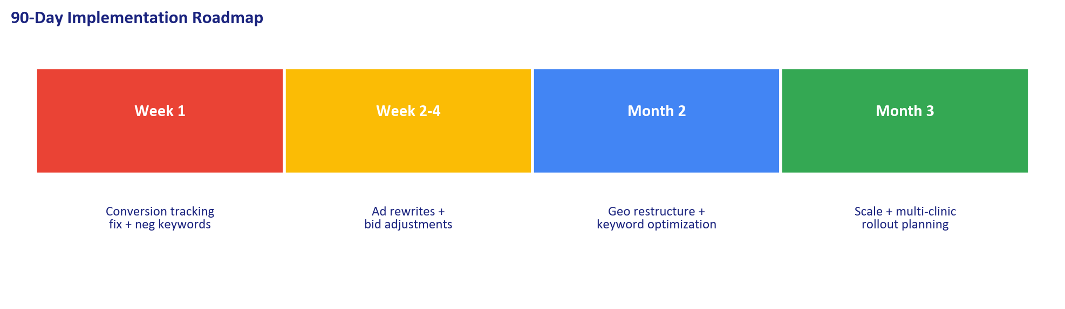
Implementation Timeline
90-Day Roadmap
Week 1
Weeks 2-4
Month 2
Month 3
Fix Foundations
Optimise
Restructure
Scale
Remove KMG ghost conversions
Move soft signals to Secondary
Negative keyword 9-list overhaul
Disable auto-apply (except ad rotation)
Rewrite all Poor/Average ads
Implement device bid adjustments
Implement schedule + day-of-week adjustments
Evaluate tCPA vs tROAS bid strategy
Geo: radius → postcode targeting
Keyword optimization (first month clean data)
Landing page traffic routing
Remove 43 paused campaigns
Scale winning campaigns
Establish per-treatment benchmarks
Multi-clinic rollout planning
Full reporting framework
Christopher Hoole | christopherhoole.com | Confidential
11

Slide 12
Ready to Start Immediately
Christopher Hoole
Next Steps
chris@christopherhoole.com
christopherhoole.com
+44 7999 500 184
1
Grant me editor access to the account
I can implement the Week 1 fixes in a single session
Conversion tracking fix + negative keyword overhaul in Week 1
£50
90 Days
+29%
2
The two highest-impact changes — immediate CPA improvement
Target CPA
To Full Impact
More Leads
3
Ad rewrites + bid adjustments in Weeks 2-4
The #1 CPA reduction lever, backed by data from all 3 reports
“The data is clear. The opportunities are identified. The plan is specific. I'm ready to implement Week 1 the day I start.” — Christopher Hoole
4
Monthly reporting from Day 1
Full transparency on what changed, why, and the measured impact

